Slide 1
Introduction to DBMS
COURSE CODE:CSA0508
COURSE:DATABASE MANAGEMENT SYSTEM
UNDER GUIDANCE OF:Dr.AYYAPPAN G
Rk.Samyuktha
192520030

Slide 2
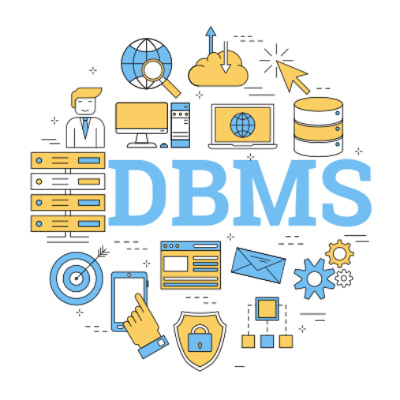
INTRODUCTION
DBMS stands for Database Management System
It is software used to manage databases
Stores and organizes large amounts of data
Allows users to create, access, update, and
delete data
Acts as an interface between users and databases
Examples include MySQL, Oracle, PostgreSQL, and SQL Server

Slide 3
OBJECTIVES
Provides a systematic method for storing data
Enables efficient data retrieval and processing
Maintains data accuracy and consistency
Provides security and controlled data access
Supports multiple users and concurrent data access
Provides backup and recovery facilities

Slide 4
ADVANTAGES
Reduces data redundancy and duplication
Prevents data inconsistency
Improves data security and privacy
Supports data sharing among multiple users
Maintains data integrity and accuracy
Provides backup, recovery, and data independence

Slide 5
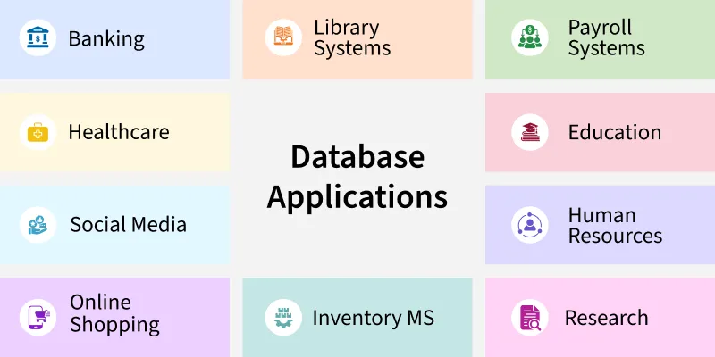
REAL-WORLD APPLICATIONS
DBMS is widely used in:
Banking – Customer accounts and transactions
Hospitals – Patient records and appointments
Universities – Student information and examination systems
E-commerce – Product and order management
Airline Reservation – Ticket booking and scheduling
Libraries – Book catalog and issue/return records

Slide 6
CONCLUSION
DBMS is essential for modern data management
It efficiently stores and organizes large amounts of data
It improves data security and reliability
It reduces redundancy and maintains consistency
It enables fast access to important information
DBMS supports diverse applications across many industries

Slide 7
THANKYOU

